Slide 1



SignQuest
Capstone Project Phase B
Students: Guy Shlomo Banbo & Elior Malik
Supervisor: Reuven Cohen

Slide 2

Table Of Content
The Problem
Our Solution
The Teaching Method
MediaPipe Holistic
The Model (LSTM)
Architecture
Model Architecture
The Dataset
Model results
Tools
Use Case Diagram
Activity Diagram
Testing
demonstration
Evaluation
user feedback
Challenges
Summary

Slide 3
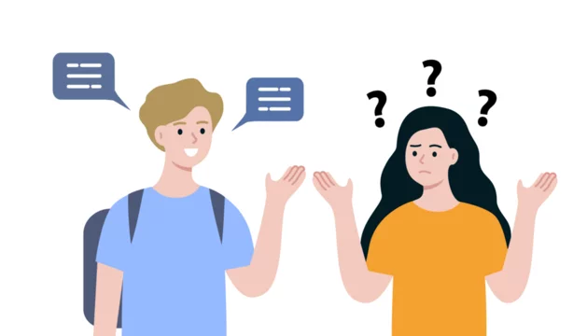
The Problem
There is a lack of using sign language among deaf people
The general population's unfamiliarity with sign language poses a significant communication barrier for those who are hearing impaired.
The availability and quality of educational resources are limited
Most of the current solutions don’t offer feedback on the user’s gestures

Slide 4
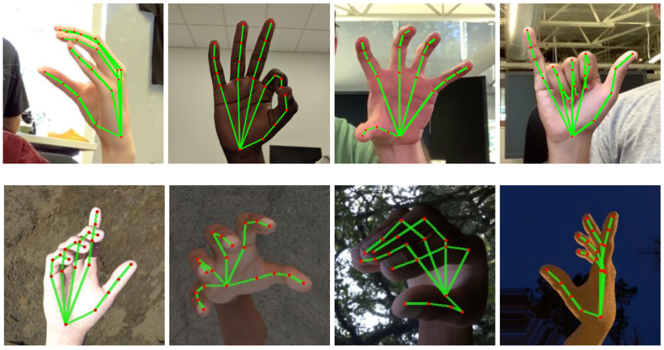
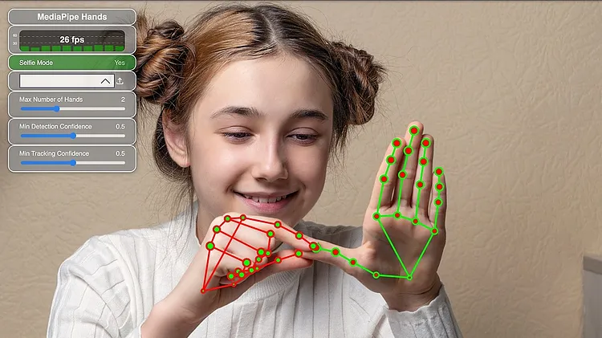

Our Solution
An application that provides an easy and intuitive way to learn the American sign language
Real time video gesture recognition using machine learning
Immediate feedback when successfully performing a gesture

Slide 5
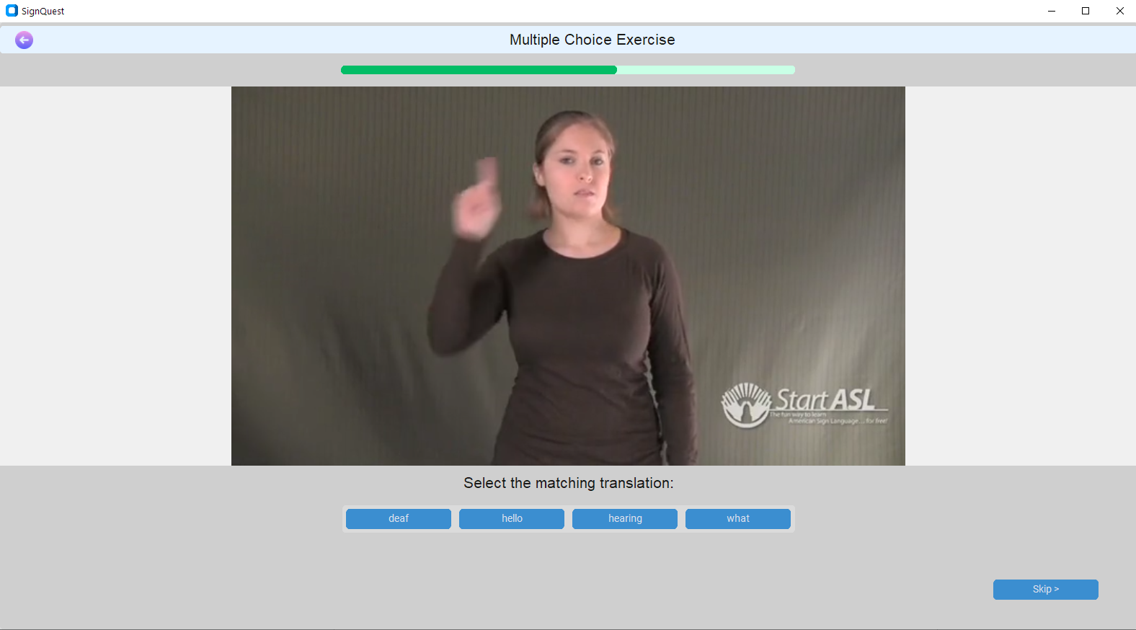
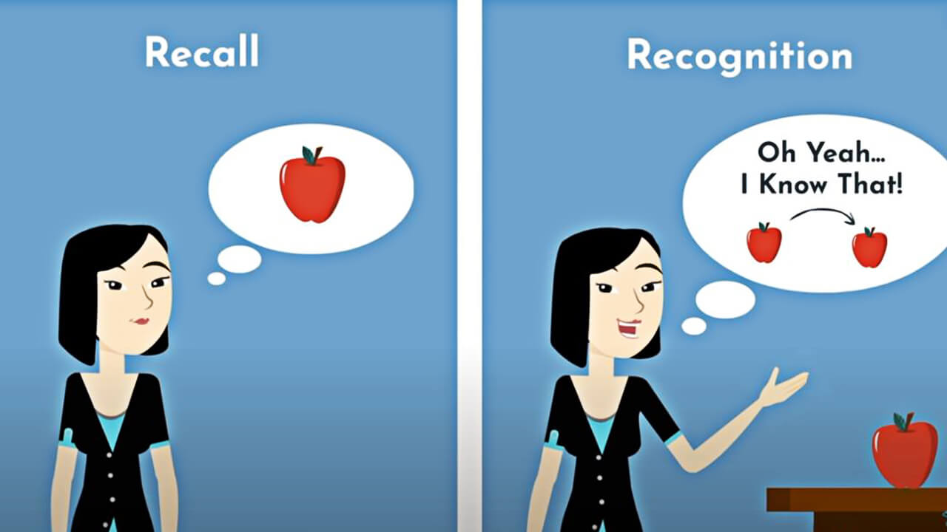
Teaching Method
The app includes different types of exercises:
Repeating a gesture
Choosing the word that matches a gesture
Typing the word that matches a gesture
Performing a gesture of a missing word in a sentence
Signing an ASL sentence
The different types of exercises are based on memory recognition and recall to ensure an effective learning process.
At the end of each lesson, a score for the lesson is calculated

Slide 6
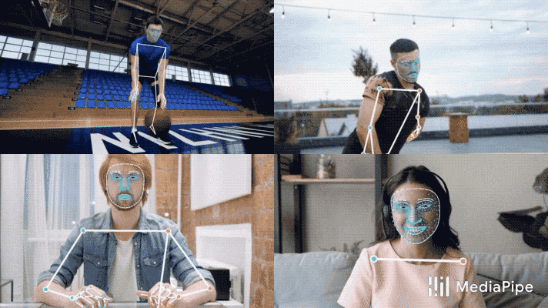

MediaPipe Holistic
MediaPipe Holistic - allows to extract signer’s gesture landmarks.
The MediaPipe holistic provides the following landmarks:
Hand - These landmarks can be used to track hand gestures, hand poses, and interactions with objects.
Pose - These landmarks can be used for pose estimation, tracking body movements, and analyzing body gestures.
Facial - These landmarks can be used for facial recognition, facial expression analysis, and facial motion tracking, among other applications.
Hand Landmarks
Example of MediaPipe Holistic

Slide 7
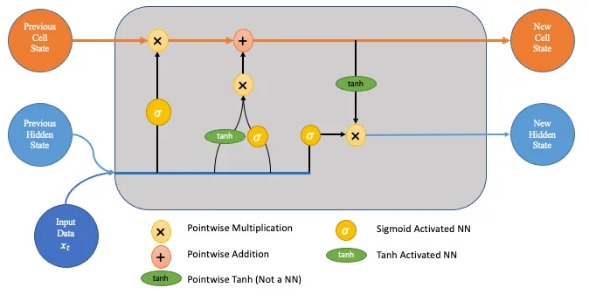
Model
Uses an LSTM(Long short-term memory) machine learning model
LSTM is a variant of RNN(Recurrent neural network), which uses sequential data or time series data
Adds special memory block called cells in hidden layer
Cells controlled by input gate, output gate, and forget gate
Enables layer to remember helpful information over longer timelines
Well-suited for modeling sequential data like sign language videos
LSTM Architecture

Slide 8
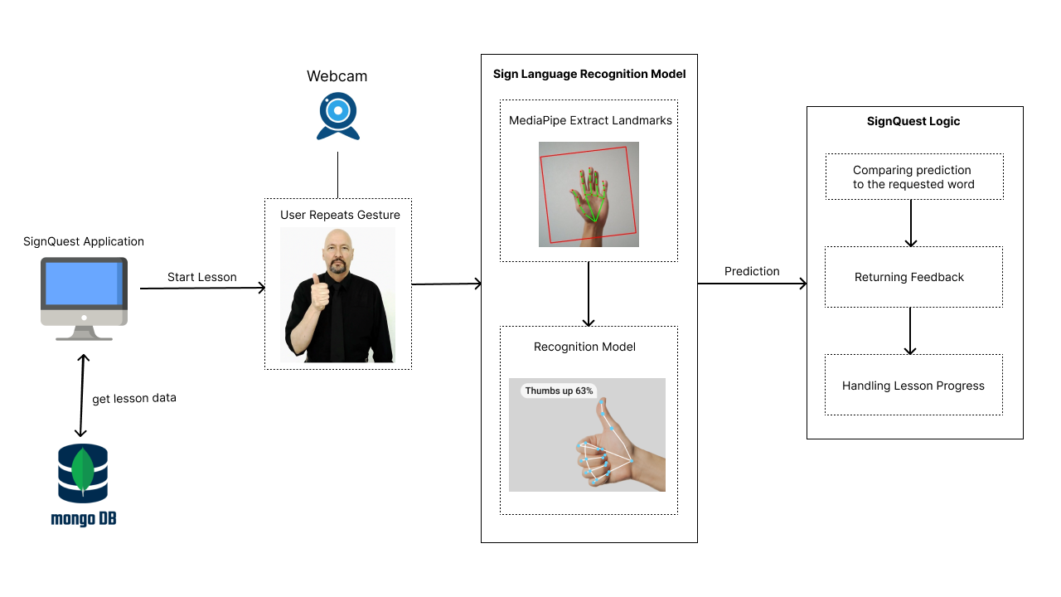
Architecture

Slide 9
Model Architecture
Input Layer
Masking
LSTM (16 Units)
LSTM
(32 Units)
LSTM
(16 Units)
Dense
(64 Units)
Dense
(32 Units)
Output

Slide 10
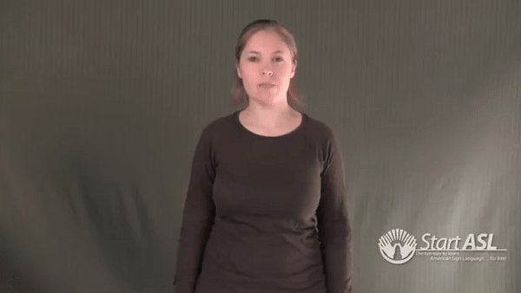
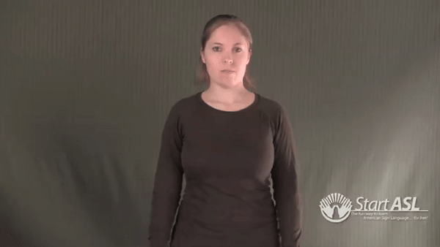
Dataset
The dataset contains videos of ASL gestures
the videos were collected mainly form 2 sources: WLASL, SignASL
videos of 30 different signs are included in the dataset
Data augmentation techniques were used due to limited number of video per word.
The dataset (after augmentation) contains more than 5000 videos.
Learn
Sign Language

Slide 11
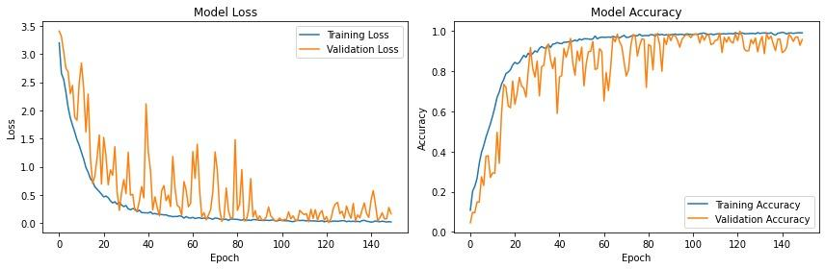
Model Results
Mediapipe was used to collect the hand key points from the videos in the dataset. The key points are the inputs the model was trained and tested on.
10% of the dataset was used for the test set, including 524 videos.
The final training loss is 0.03 and the training accuracy is 99%.
The final test loss is 0.07 and the test accuracy is 98%.
The model's excellent performance is demonstrated by its low loss value and high accuracy across both the training and test sets

Slide 12
Main Tools We Used
Tensorflow- provided different machine learning tools, including LSTM.
LSTM - used for building the model
MediaPipe - library used for extracting hand key points from videos
Tkinter- library used for developing the user interface
OpenCV - library used for capturing live camera feed
MongoDB - database used for storing lessons and users information

Slide 13
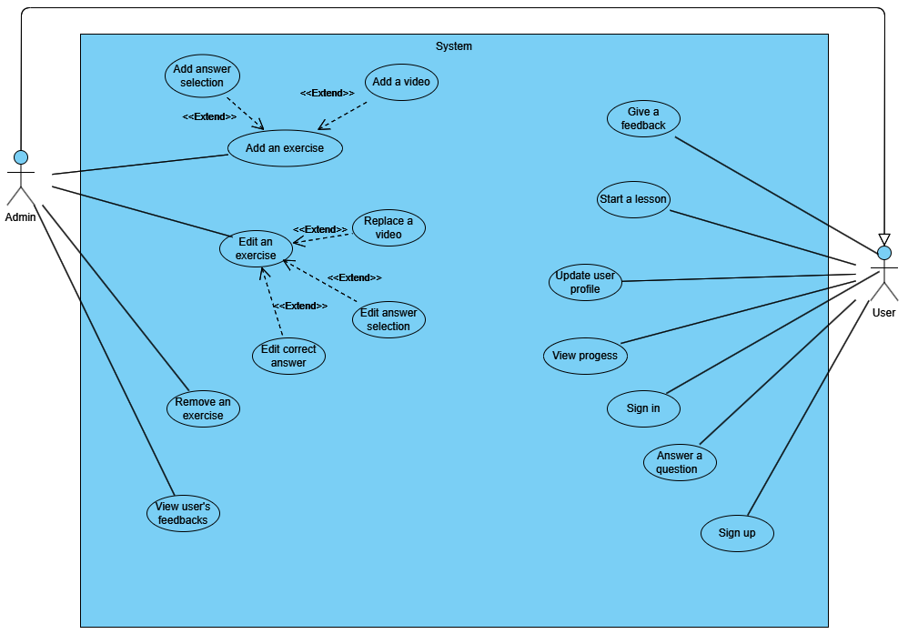
Use Case Diagram

Slide 14
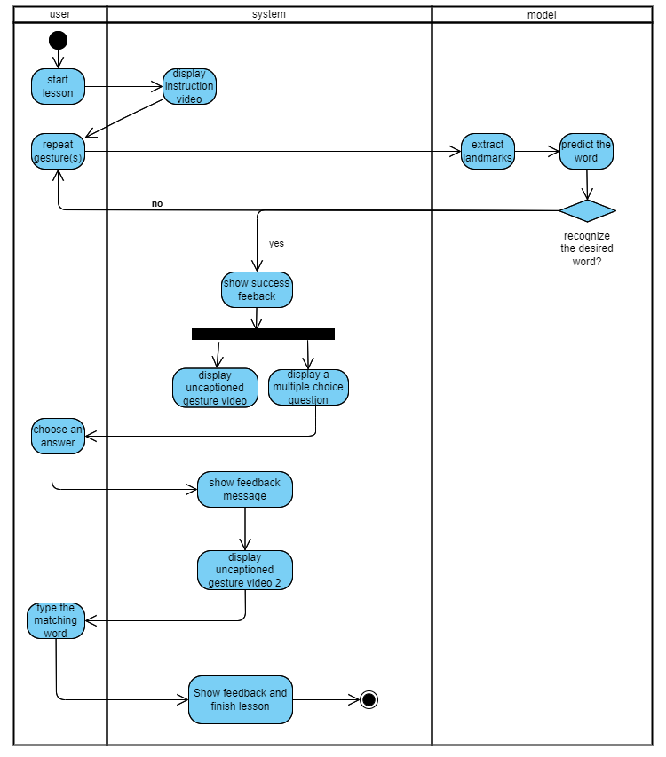
Activity Diagram

Slide 15
Testing
ID | Action | Expected result | Actual Result
1 | Signing up | Success message New user created in the database. page redirects to login | pass
2 | Signing in | Success message File with user credentials created page redirects to homepage | pass
3 | User updating his profile | User profile is updated with the new information. | pass
4 | User viewing homepage | showing all available lessons showing toolbar | pass
5 | User answering a question | giving a feedback according to the answer moving to the next question | pass
6 | User viewing his progress | Correctly shows the user's progress: completed lessons ,words and scores of completed lessons. | pass
7 | User watching an instruction video | Correctly shows instruction video corresponding to the word | pass
8 | User submit a feedback | Success message New feedback is added to the DB with a rating,review and date. | pass
9 | Admin adding an exercise | Success message New exercise is added to the DB with a type, correct answer, video link and list of possible answers | pass
10 | Admin editing an exercise | Success message the new exercise information updated in the DB with a type, correct answer, video link and list of possible answers | pass
11 | Admin viewing user’s feedback | All user’s feedback will be shown, with review, rating and date. | pass
12 | User performs sign language gestures | accurately recognizing users’ performed gesture showing feedback to the user | pass

Slide 16
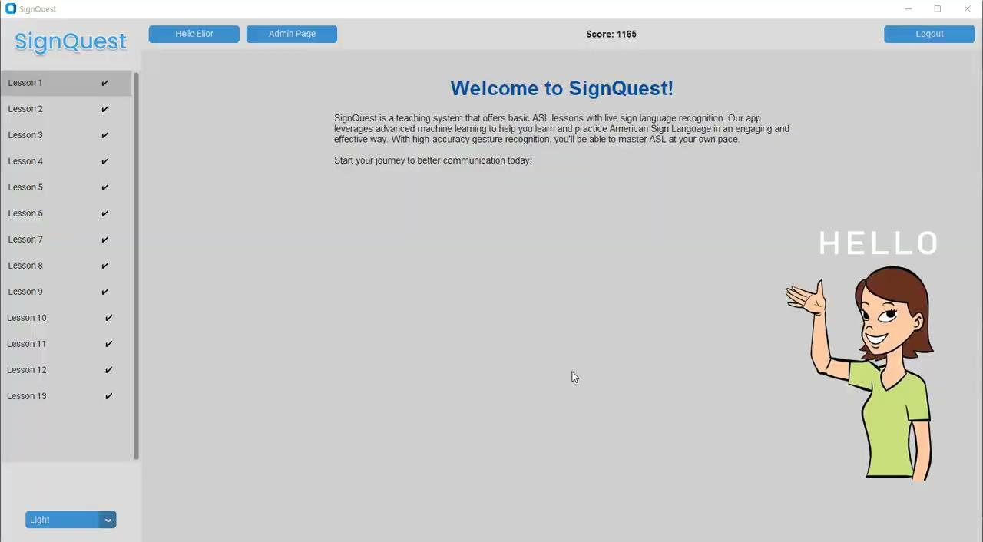
Demonstration

Slide 17
Evaluation
The evaluation of the application focuses on accuracy, performance and user experience:
Accuracy:
Goal: 77% test accuracy.
Achieved: 98% test accuracy.
Performance:
Real-time gesture prediction is made within seconds.
User Learning:
Test users achieved an average score of 80% per lesson, surpassing our 75% target.
User Experience:
User feedback, collected via questionnaires, was positive, highlighting smooth and effective learning.

Slide 18
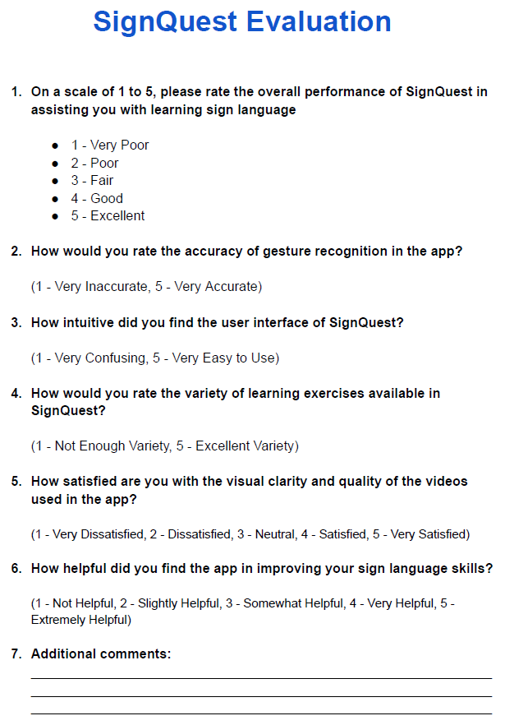
User Feedback
Question | Most common answer
1 | Good
2 | Accurate
3 | Easy to use
4 | Good Variety
5 | Satisfied
6 | Very Helpful

Slide 19
Challenges
High computational resources required for training LSTM model
Number of videos per word in existing datasets is limited
Different length of videos in the dataset
Creating an effective Teaching Method
ASL has different syntax from English
Different gestures for the same word
English Sentence: I am going to the store.
ASL Structure: Store,Me Go
Subject-Verb-Object Order
Subject-Object-Verb Order

Slide 20
Summary
The sign recognition model achieved a 98% test accuracy, exceeding initial targets.
Managed challenges such as limited dataset size and creating an effective teaching method.
User performance and feedback confirm the system provides a valuable ASL learning experience.
The application’s user interface achieved positive user feedback.

Slide 21
Thank you
Any Questions?

